Slide 1

Enter the amusement park

Slide 2
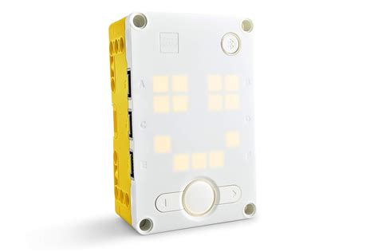
Hub

Slide 3
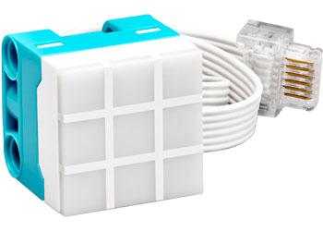
Colour Light Matrix

Slide 4
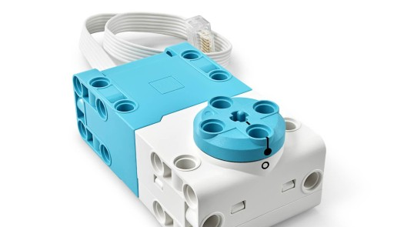
Motor

Slide 5
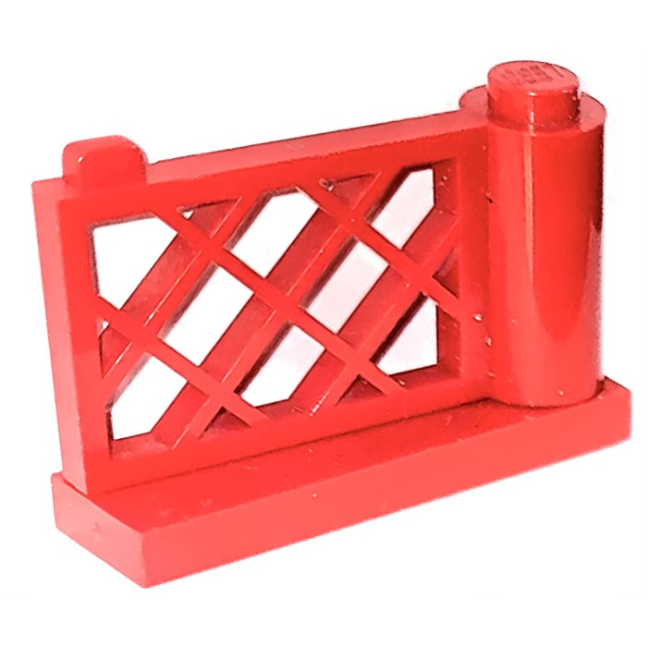
The gate

Slide 6
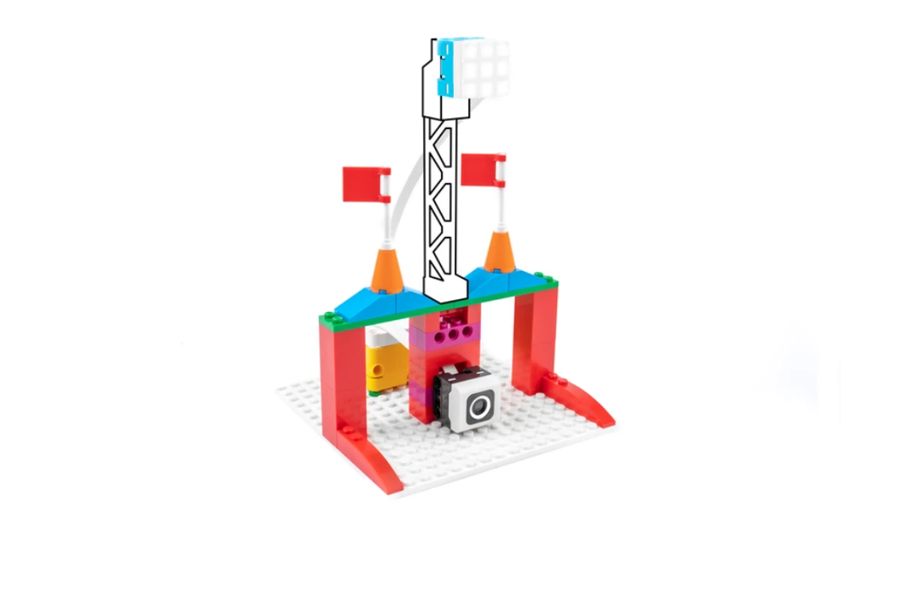
Let's build an amusment park entrance

Slide 7
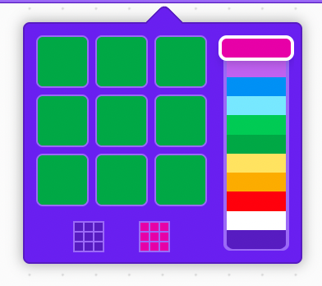
Choose the entrance colour

Slide 8
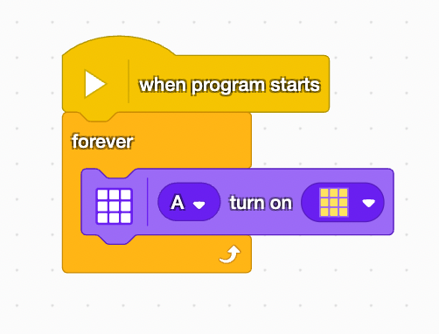
When your program starts let's turn on the lights

Slide 9
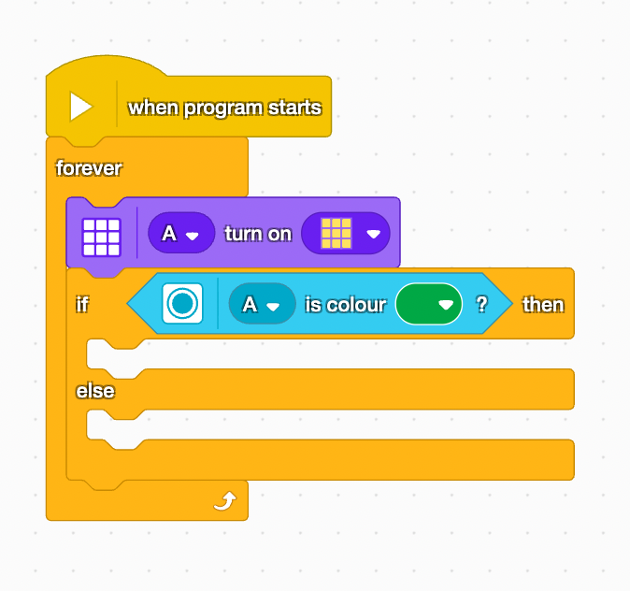
Then sense for the right colour

Slide 10
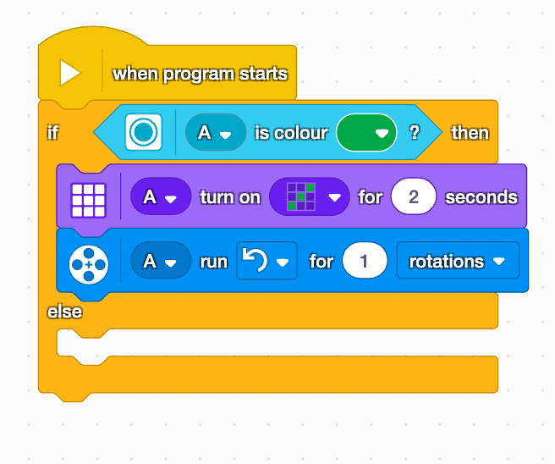
If the colour is right then turn on the lights and let the gate be open

Slide 11
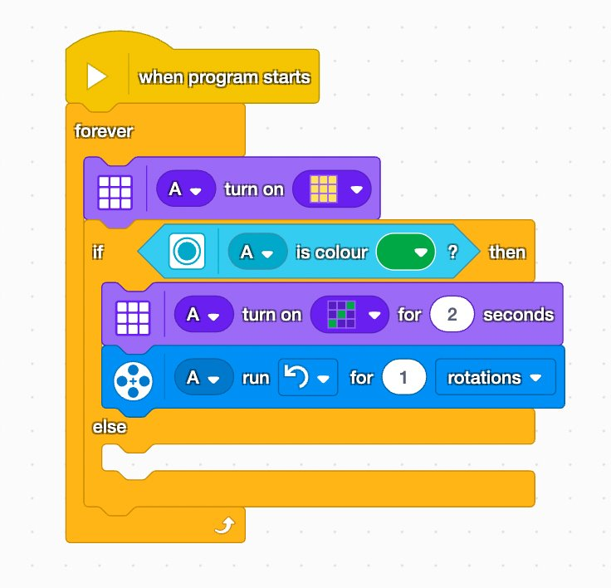
If the colour is right, then switch to the entry colour light and let the gate be open

Slide 12
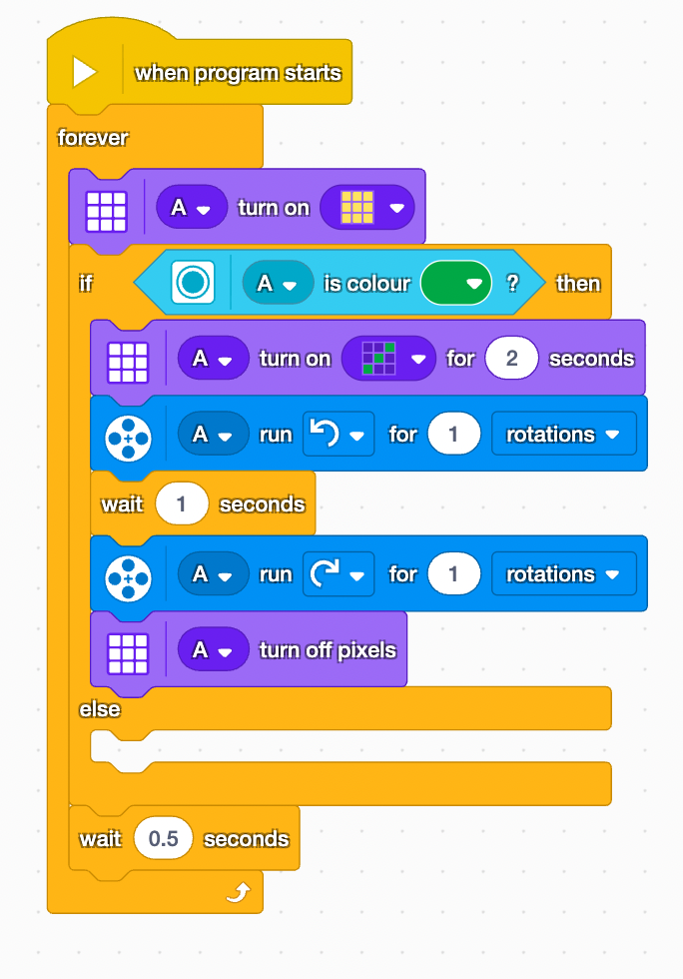
Let's be sure to close the gate shorlty after

Slide 13
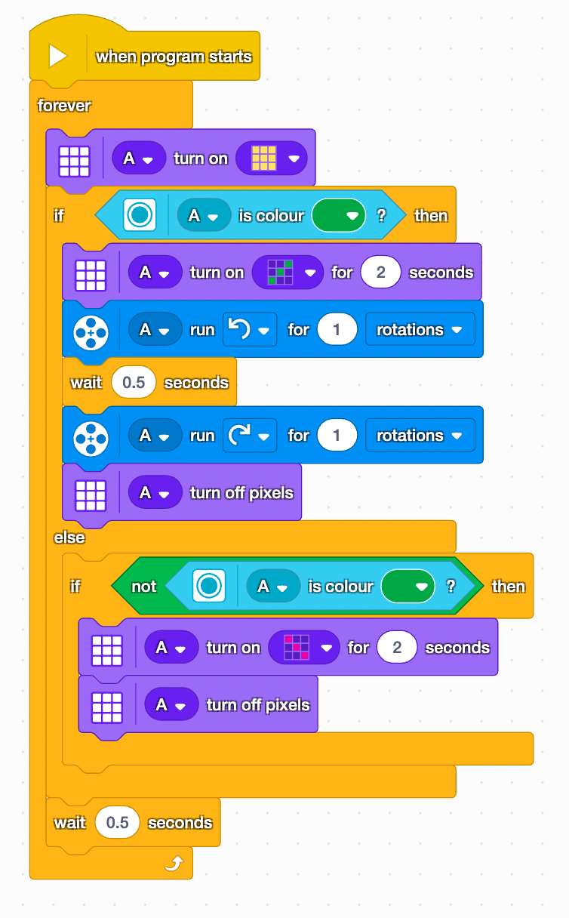
If it’s the wrong colour the switch to the none entry colour lights

Slide 14
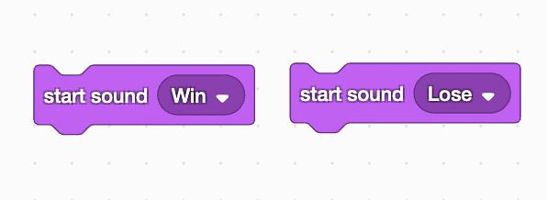
Challenge:
Add two sounds one for entry, anotherfor no enty

Slide 15
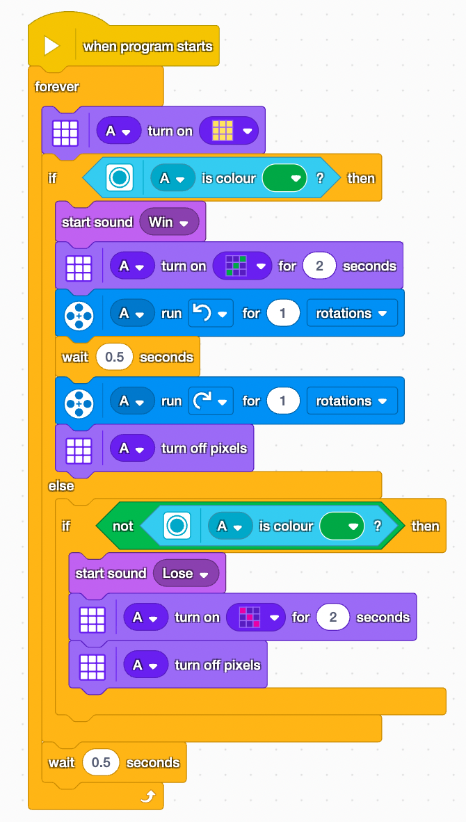
The comple code

